Slide 1

UNIVERSITY INSTITUTE OF ENGINEERING
COMPUTER SCIENCE ENGINEERING
Bachelor of Engineering (Computer Science & Engineering)
Subject Name: Big Data Analytics
Subject Code: 20CST-471
Characteristics of Big data
Mapped with CO1
Prepared By:
Er. Ankita Sharma
DISCOVER . LEARN . EMPOWER

Slide 2
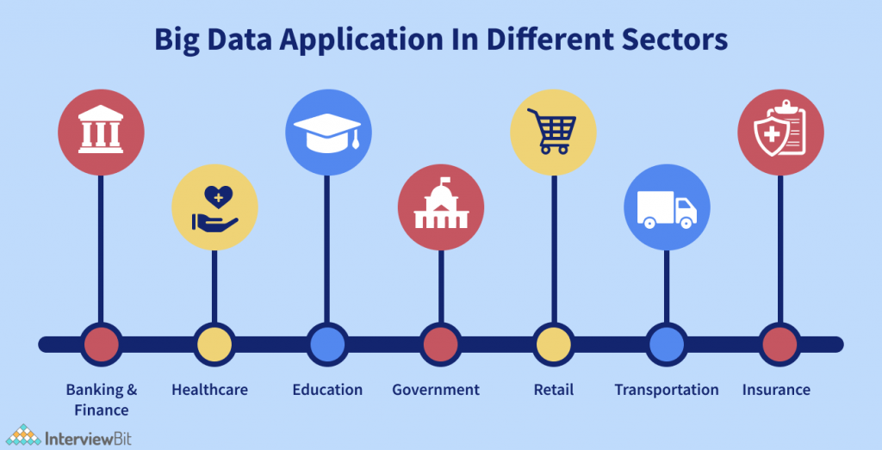
Applications of Big data

Slide 3
Healthcare:
Big Data analytics in healthcare involves analyzing large volumes of patient data to improve diagnostics, treatment plans, and patient outcomes. It enables predictive modeling for disease prevention, personalized medicine, and the optimization of healthcare delivery.
Finance:
In the financial sector, Big Data is used for fraud detection, risk management, and algorithmic trading. Analyzing large datasets helps financial institutions identify unusual patterns and make real-time decisions to mitigate risks.
Retail and E-commerce:
Retailers leverage Big Data to analyze customer behavior, preferences, and purchasing patterns. This information is used to personalize marketing campaigns, optimize inventory management, and enhance the overall customer experience.

Slide 4
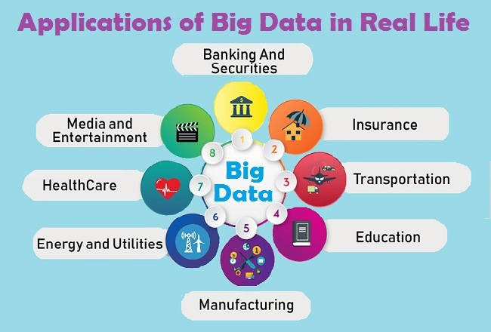

Slide 5
Manufacturing and Supply Chain:
Big Data is applied in manufacturing to improve production efficiency, quality control, and predictive maintenance. In supply chain management, it helps optimize logistics, reduce costs, and enhance overall supply chain visibility.
Telecommunications:
Telecom companies use Big Data for network optimization, predicting and preventing network failures, and analyzing customer usage patterns. It also plays a role in improving customer service and optimizing pricing strategies.
Marketing and Advertising:
Big Data analytics is crucial in marketing for targeted advertising, customer segmentation, and campaign optimization. Marketers use data to understand consumer behavior, preferences, and the effectiveness of marketing initiatives.

Slide 6
Education:
In the education sector, Big Data is employed for personalized learning, student performance analysis, and predictive analytics to identify students at risk of falling behind. It helps educators tailor teaching methods to individual student needs.
Smart Cities:
Big Data contributes to the development of smart cities by analyzing data from various sources, such as sensors and IoT devices. It helps optimize traffic management, energy consumption, waste management, and overall urban planning derive meaningful insights from disparate sources.

Slide 7
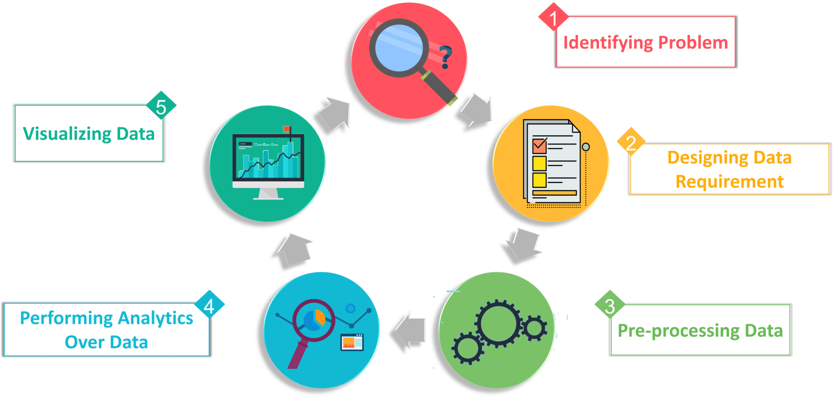

Slide 8
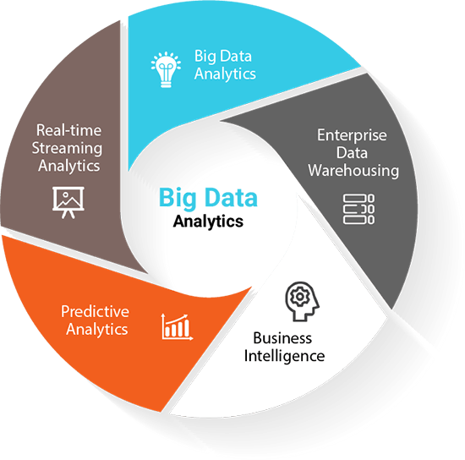

Slide 9
Human Resources:
Big Data is used in HR for talent acquisition, workforce planning, and employee engagement. Analytics can help identify the best candidates for a job, predict employee turnover, and optimize workforce productivity.
Energy Sector:
In the energy industry, Big Data is applied for predictive maintenance of equipment, optimizing energy consumption, and improving the efficiency of renewable energy sources. It plays a vital role in smart grid management.
Big Data analytics must be flexible enough to handle this diversity, employing techniques like data integration and processing to

Slide 10
Thankyou

